Slide 1

Cities Climate Summit II:
A Model for Success

Slide 2
WELCOME !
By
Brian Emanuels
(from Mercer Island PCA)

Slide 3
First, some room logistics:
Exits
Restrooms

Slide 4

WHAT IS PEOPLE FOR CLIMATE ACTION?
A growing coalition of separate city groups, each made up of local residents concerned about climate change.
Started in May 2018

Slide 5
Ten current PCA City Groups in:
Mercer Island, Seattle, Bellevue, Kirkland, Redmond, Kenmore, Bothell, Woodinville, Sammamish, & Issaquah .
New PCA group kick-offs planned soon in:
Renton, Burien, and Des Moines.
More groups in the works.

Slide 6
PCA MISSION:
Help local governments achieve their greenhouse gas reduction targets as described under the 2014 King County-Cities Climate Collaboration (K4C) agreement , i.e.:
                25% GHG reduction by 2020
                50% GHG reduction by 2030
                80% GHG reduction by 2050

Slide 7
TODAY’S EVENT SCHEDULE
9:40-- Why we are showcasing Portland --Claire Waltman
9:45-- Feature Speaker: Susan Anderson
10:25-- Q & A with Susan Anderson
11:00-- Short stretch break
11:05-- Citizens Climate Lobby presentation
by Gwen Hansen & Ian James
11:20-- Looking forward with Megan Smith & Court Olson
11:35-- Restroom break (while room divided for breakouts)
11:45-- City groups break outs, while public officials
have more Q &A with Susan Anderson
12.15-- Adjourn and cleanup

Slide 8
Introducing
Claire Waltman
(from PCA Bellevue)

Slide 9
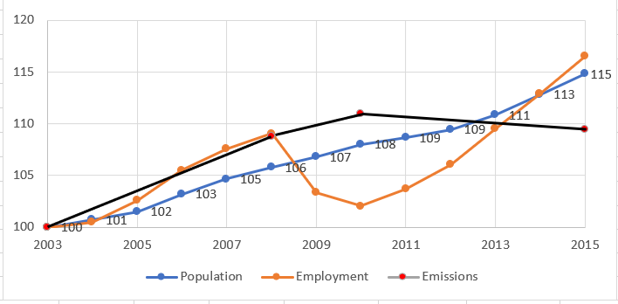
PCA is concerned about King Co. GHG reductions
Change in Greenhouse Gas Emissions using 2003 = 100 %

Slide 10
PCA Research found just a few city successes:
Fort Collins Colorado
Cambridge Massachusetts
Portland Oregon

Slide 11
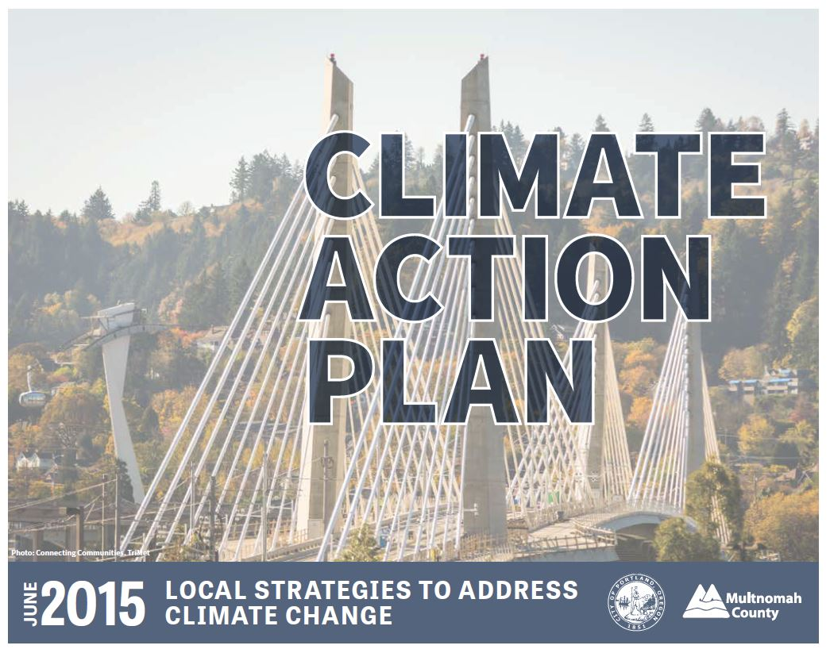
Portland/Multnomah County

Slide 12
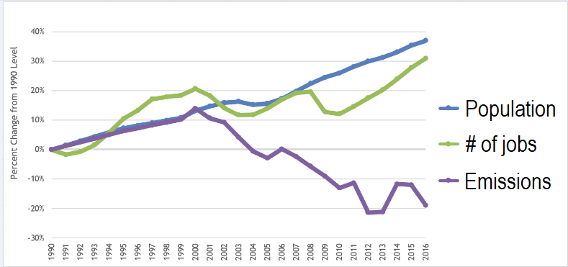
Portland + Multnomah County Trends
Population and jobs up, carbon emissions down
From 2015 Climate Action Plan, with updates from City of Portland

Slide 13
Introducing
Susan Anderson
Recently retired
Planning and Sustainability Bureau Director
City of Portland

